Slide 1
Project 4
Trong, Luz & Kirsty
Machine Learning

Slide 2

TOPIC AREA
Identify suitable data source
Define steps and methods
Global Data on Sustainable Energy – 20-year insights

Slide 3

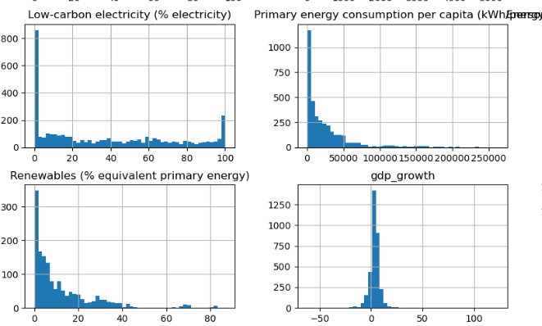
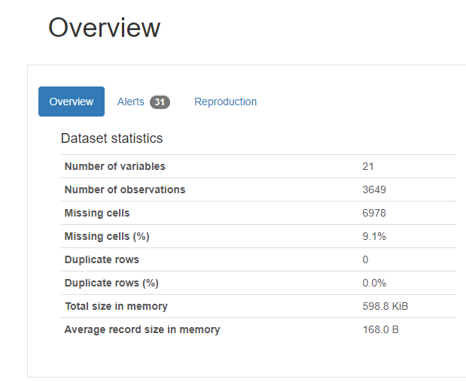
EXPLORATORY
DATA
ANALYSIS
ydata-profiling in pandas
The package outputs a simple and digested analysis of the data

Slide 4

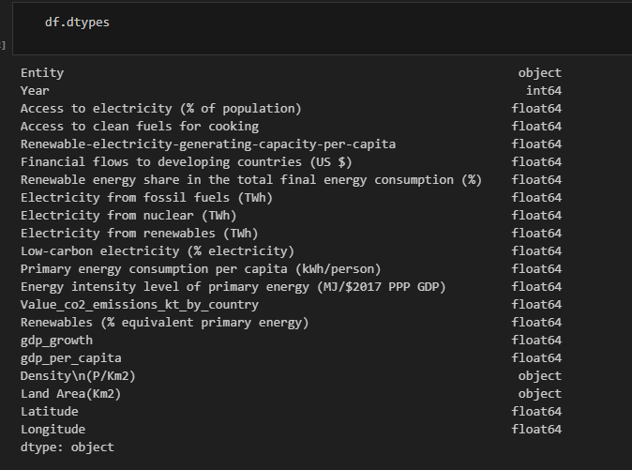
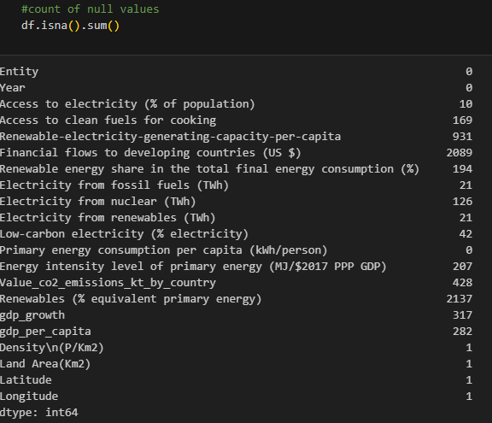

Extract
Transform Load
Exploratory analysis
Data cleaning
Data transformation

Slide 5
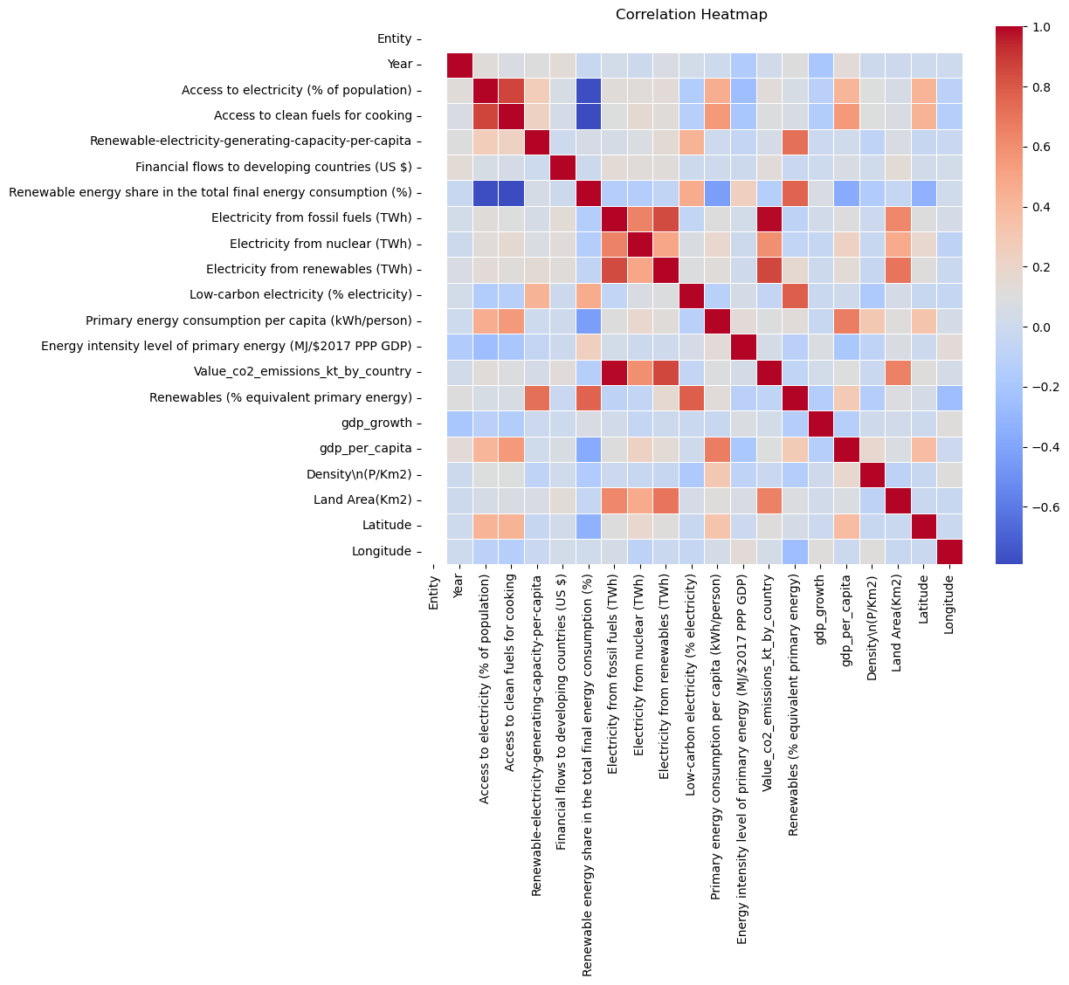
Numerical Features

Slide 6


Visualisations
Notes:
To use this title animation slide with a new image simply 1) move the top semi-transparent shape to the side, 2) delete placeholder image, 3) click on the picture icon to add a new picture, 4) Move semi-transparent shape back to original position, 5) Update text on slide.

Slide 7
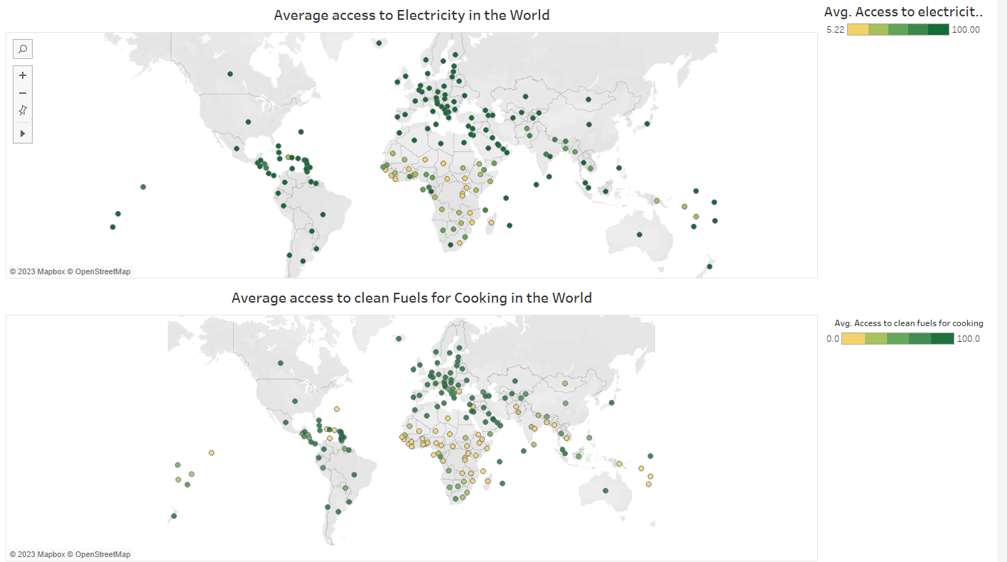

Slide 8
Machine Learning

Slide 9
Model Implementation
Python: NumPy, Pandas, Seaborn, Matplotlib
Machine Learning: Scikit-learn
Clustering: Kmeans, StandardScaler
Regression Analysis: LinearRegression, statsmodels
Decision Tree Classifier: Using Scikit-Learn to train a Decision Tree

Slide 10
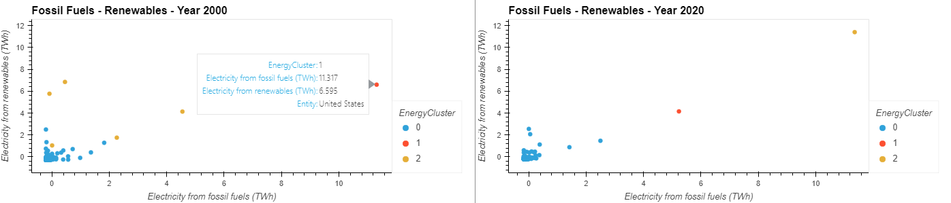
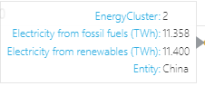
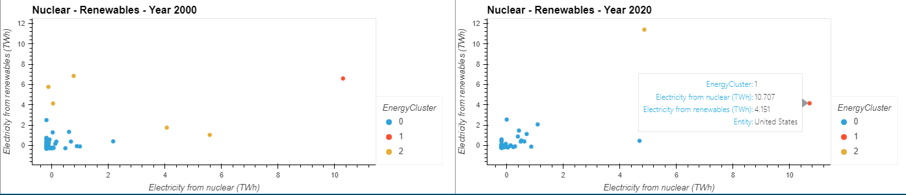
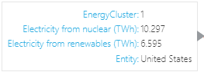
Clustering

Slide 11
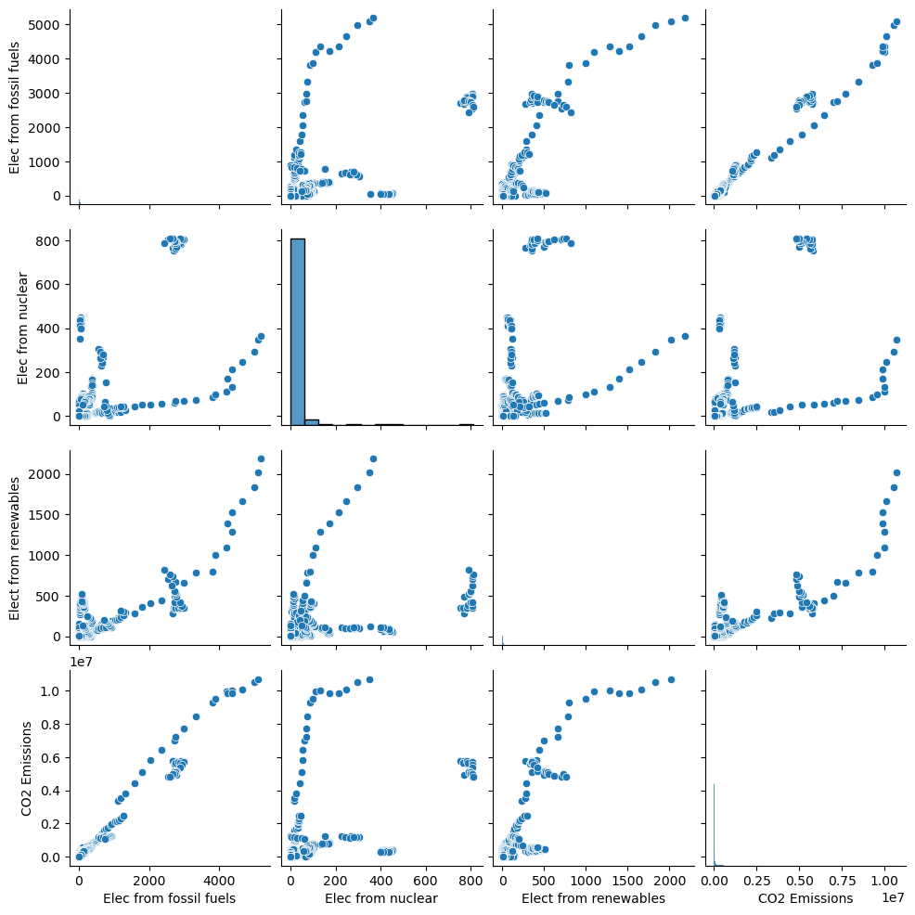
Linear Regression
Pairplot
Understanding the data

Slide 12
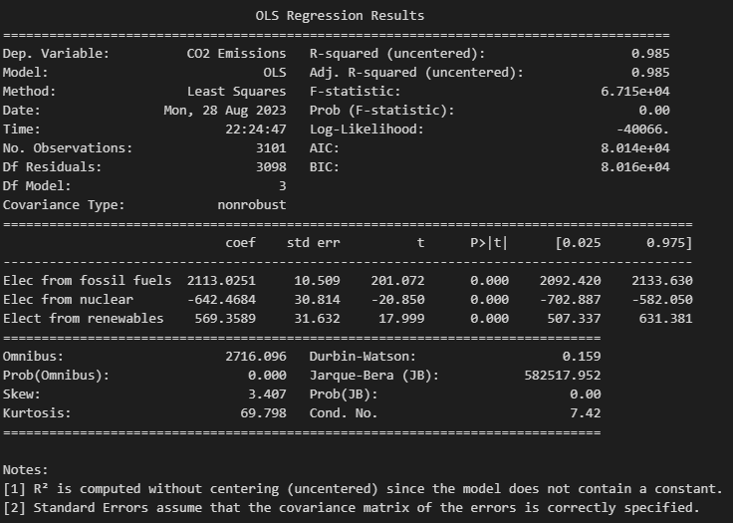
Ordinary Least
Squares

Slide 13

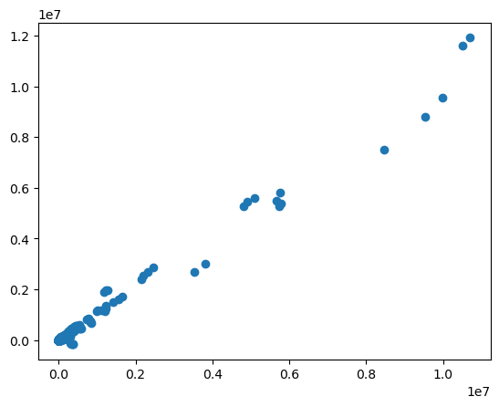

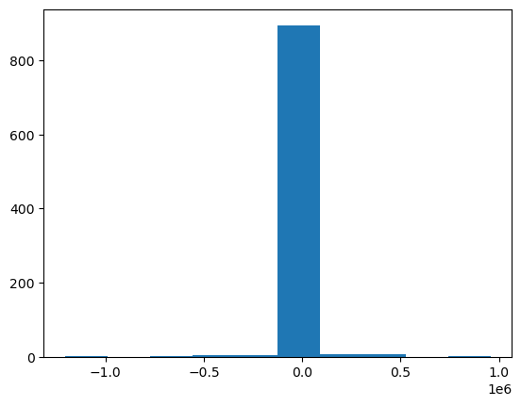
Model’s Performance

Slide 14
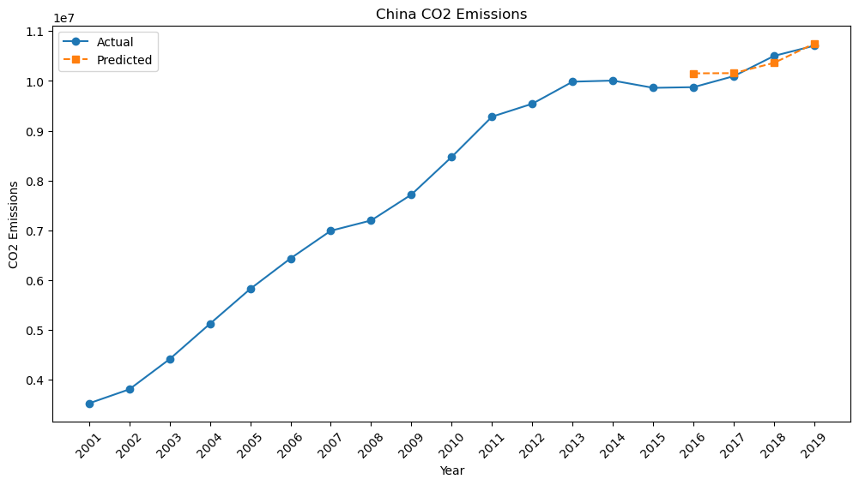
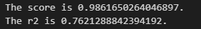
CO2 Emissions - Trends

Slide 15
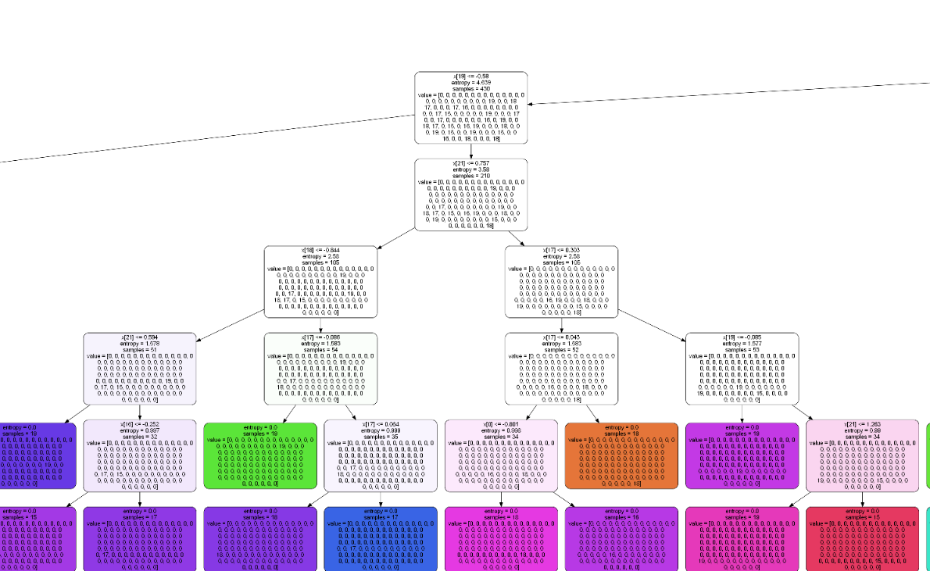
Decision
Tree
Find the best model to predict the Energy Transition Index (ETI) ranking for each country in 2020.
The ETI ranking by country for 2020 is the ‘target variable’.
Use of the Decision Tree Supervised Learning method as a classification method to predict discrete variables.

Slide 16
DECISION TREE
Grid Search Cross Validation:
Hyperparameters: A hyperparameter is a parameter whose value cannot be determined from data. Criterion ‘gini’ and ‘entropy’ – tree specific like Random Forest.
Grid search: is a tool that builds a model for every combination of hyperparameters we specify and evaluates each model to see which combination of hyperparameters creates the optimal model.
param_grid dictionary contains every hyperparameter to tweak a model along with a list of different inputs for that parameter.

Slide 17
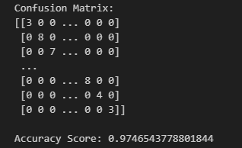
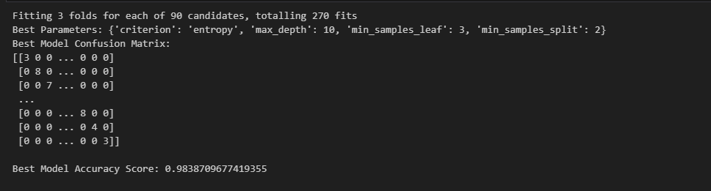
Decision Tree - Evaluation
Best Model

Slide 18
Thank you.
for listening

